Slide 1
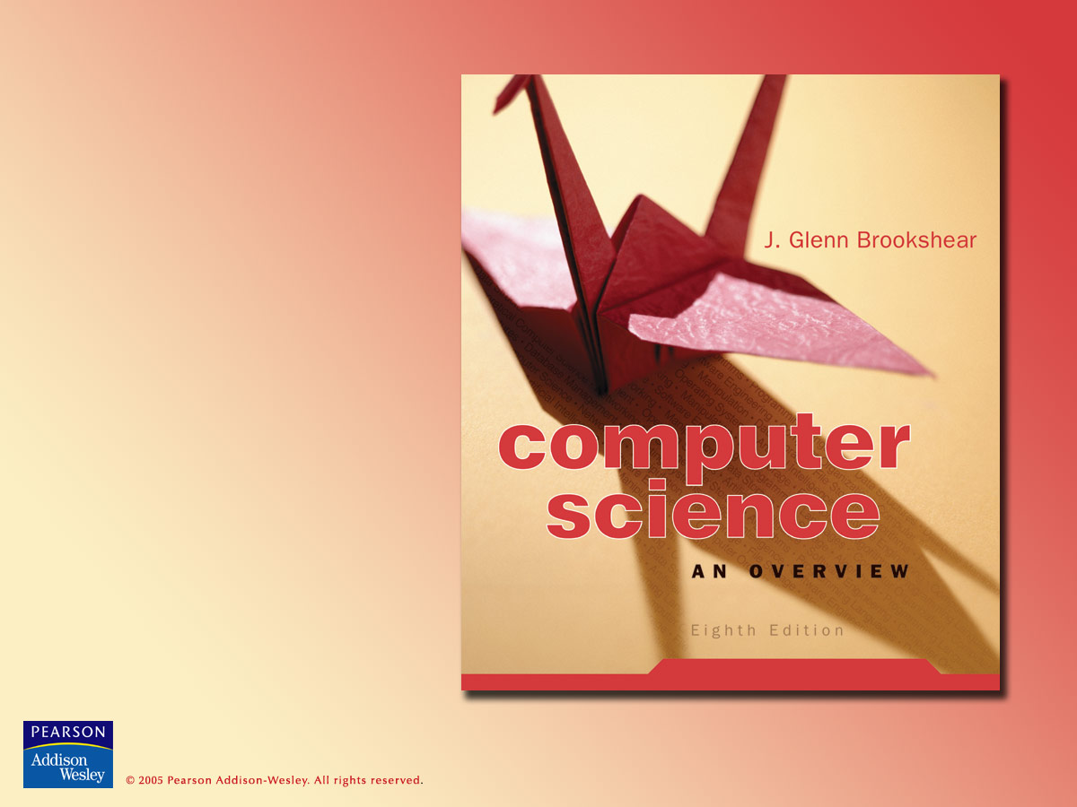
Chapter 0
Introduction

Slide 2

Chapter 0: Introduction
0.1 The Role of Algorithms
0.2 The Origins of Computing Machines
0.3 The Science of Algorithms
0.4 Abstraction
0.5 An Outline of Our Study
0.6 Social Repercussions

Slide 3
Algorithms: Definitions
Algorithm = a set of steps that defines how a task is performed.
Program = a representation of an algorithm.
Programming = the process of developing a program.
Software = programs + algorithms.
Hardware = machinery: whatever isn’t software.

Slide 4
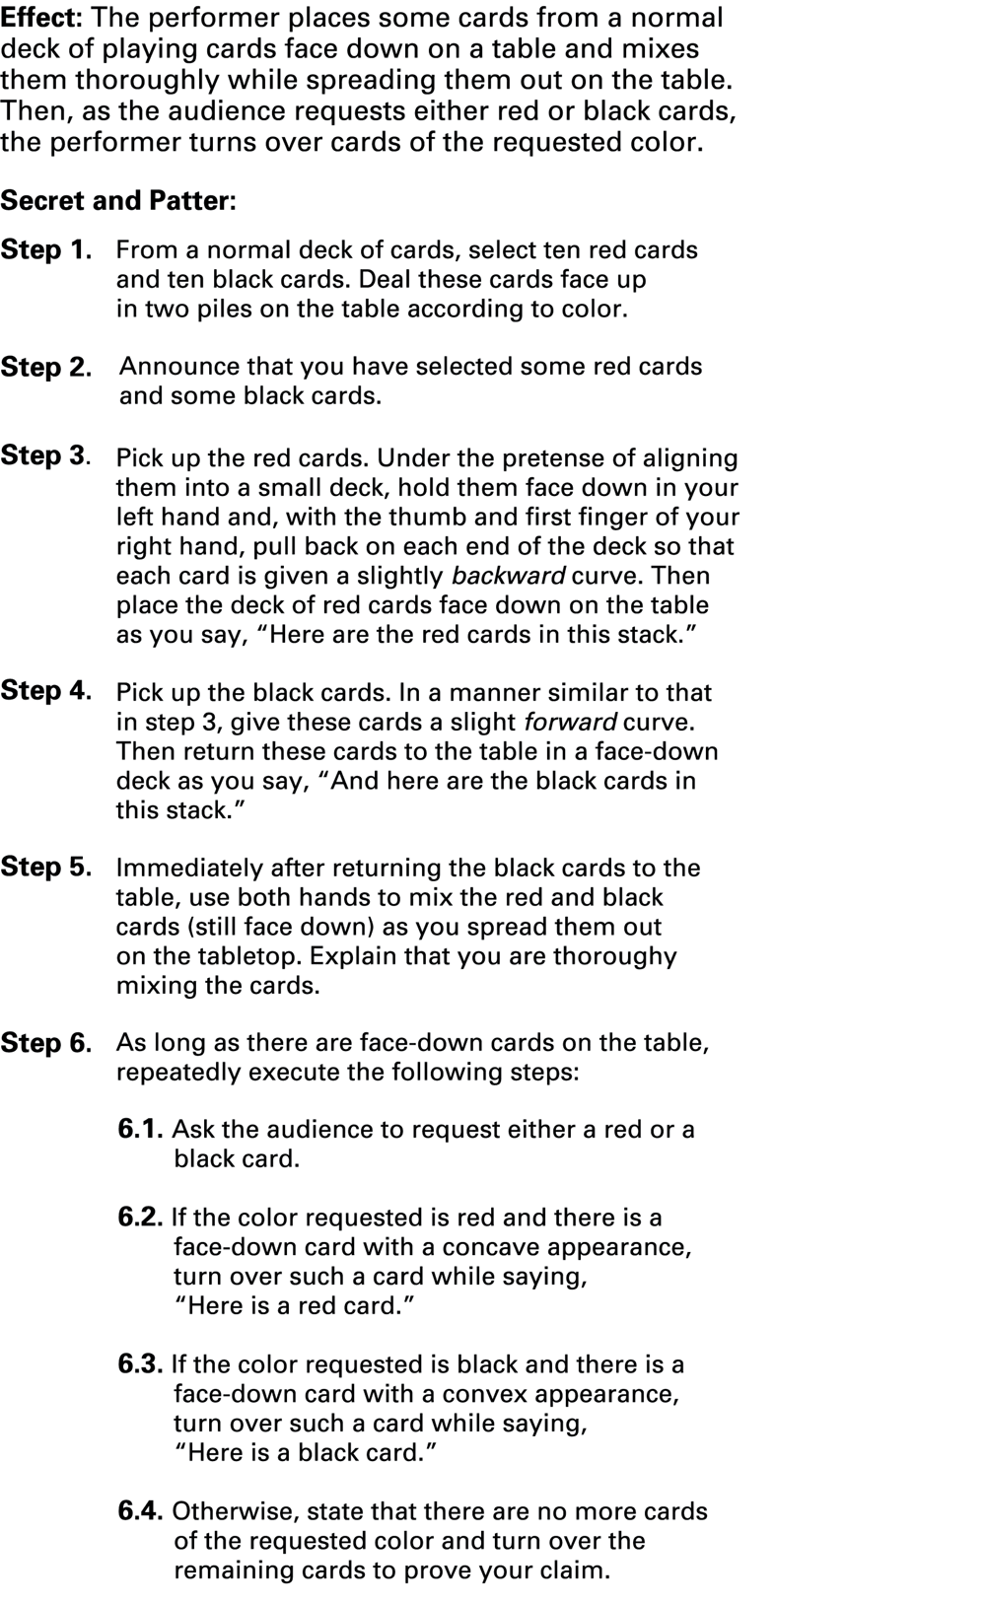
Figure 0.1 An algorithm for a magic trick

Slide 5
Figure 0.1 An algorithm for a magic trick (cont’d)

Slide 6
History of Algorithms
The study of algorithms was originally a subject in mathematics.
  Algorithms were studied before computers existed.
Early examples of algorithms
  Long division algorithm
  Euclidean Algorithm
Gödel's Incompleteness Theorem: some problems cannot be solved by algorithms

Slide 7
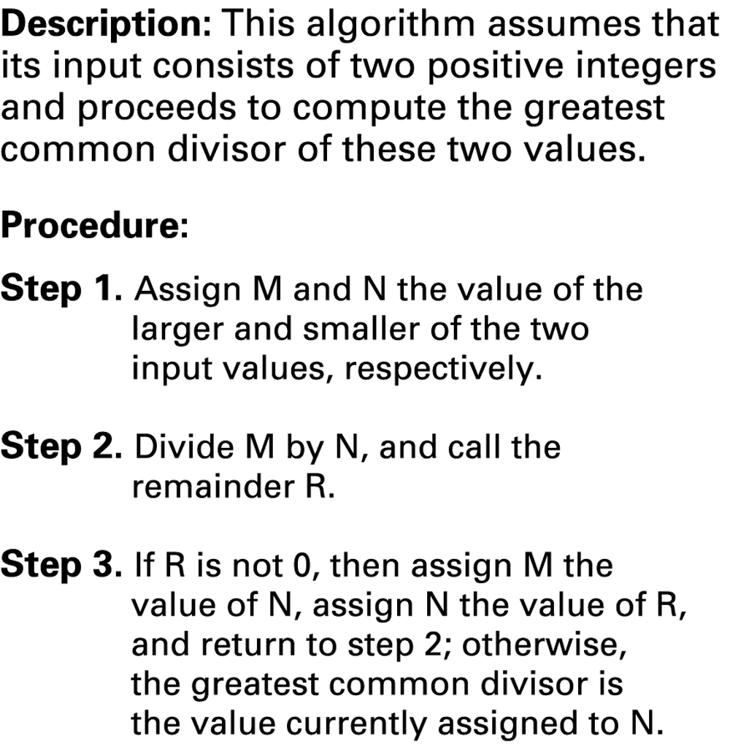
Figure 0.2 The Euclidean algorithm for finding the greatest common divisor of two positive integers

Slide 8
Origins of Computing Machines
Early computing devices
  Abacus: positions of beads represent numbers
  Gear-based machines (1600s-1800s)
    Positions of gears represent numbers
    Blaise Pascal, Wilhelm Leibniz, Charles Babbage

Slide 9
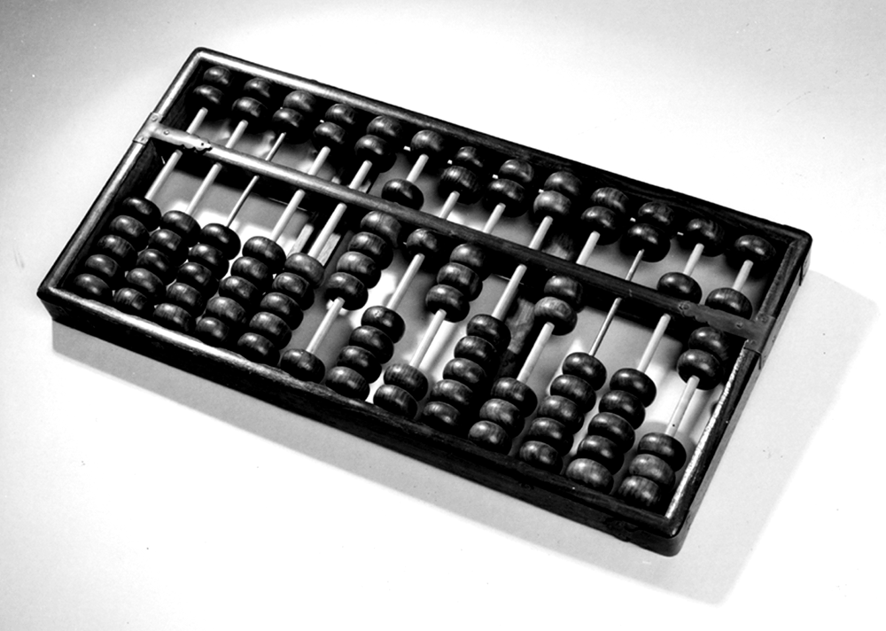
Figure 0.3 An Abacus

Slide 10
Origins of Computing Machines
Early data storage: punched cards
  First used in Jacquard Loom (1801) to store patterns for weaving cloth
  Stored programs in Babbage’s Analytical Engine
  Popular through the 1970’s

Slide 11
Early computers
Based on mechanical relays
  1940: Stibitz at Bell Laboratories
  1944: Mark I: Howard Aiken and IBM at Harvard
Based on vacuum tubes
  1937-1941: Atanasoff-Berry at Iowa State
  1940s: Colossus: secret German code-breaker
  1940s: ENIAC: Mauchly & Eckert at U. of Penn.

Slide 12
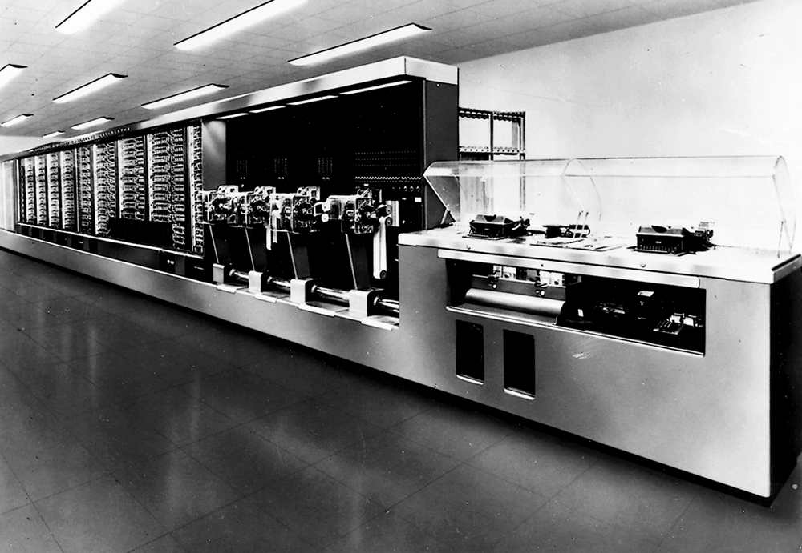
Figure 0.4 The Mark I computer

Slide 13
Personal computers
  First used by hobbyists
  1981: IBM introduces the PC
    Accepted by business
    Became the standard hardware design for most desktop computers
    Most PCs use software from Microsoft

Slide 14
Computer Science
The science of algorithms
Draws from other subjects, including
  Mathematics
  Engineering
  Psychology
  Business Administration
  Psychology

Slide 15
Central Questions of Computer Science
Which problems can be solved by algorithmic processes?
How can discovery of algorithms be made easier?
How can techniques of representing and communicating algorithms be improved?
How can our knowledge of algorithms and technology be applied to provide better machines?
How can characteristics of different algorithms be analyzed and compared?

Slide 16
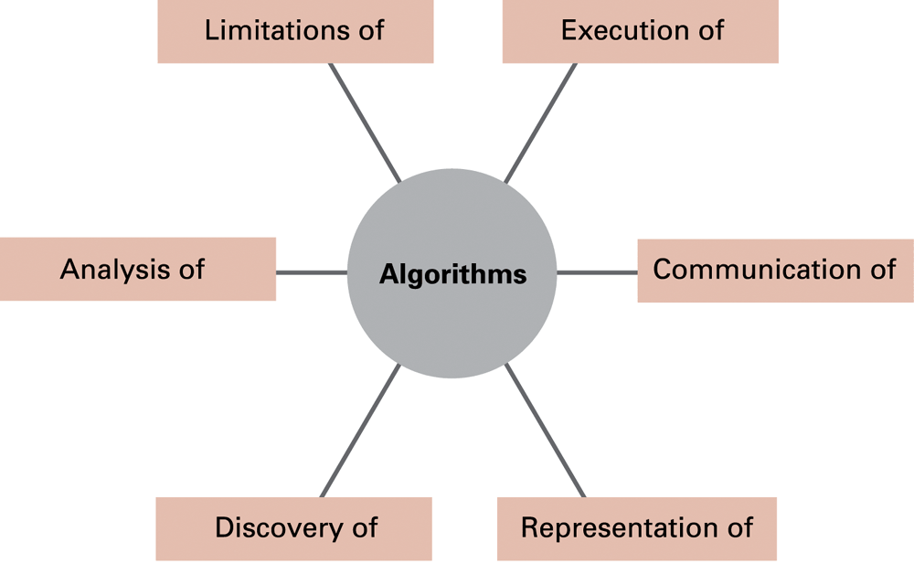
Figure 0.5 The central role of algorithms in computer science

Slide 17
Abstraction: Definitions
Abstraction = the distinction between the external properties of an entity and the details of the entity’s internal composition.
Abstract tool = a component of a larger system whose internal composition we ignore.

Slide 18
Uses of abstraction
Abstraction allows us to use things we don’t fully understand.
We all can use electrical devices, food, etc. that we either do not understand or cannot produce.
Computer scientists can use algorithms implemented by others without understanding their details.

Slide 19
Outline of our study
Design and construction of computing machines
  Chapter 1: Data storage
  Chapter 2: Data manipulation
Chapter 3: Operating systems
Chapter 4: Networks and the internet
Chapter 5: Algorithms

Slide 20
Outline of our study (continued)
Chapter 6: Programming languages
Chapter 7: Software engineering
Data organization
  Chapter 8: Data abstractions
  Chapter 9: Database systems
Chapter 10: Artificial intelligence
Chapter 11: Theory of computation

Slide 21
Social Repercussions
Computers enable new activities, raising new questions:
  Law: software producer’s rights and liabilities
  Ethics: what newly enabled activities are immoral?
  Government: which newly enabled activities should be regulated?
  Society: how do computers affect our lives?
This book should prepare the reader to participate intelligently in debates of these issues.

